Slide 1

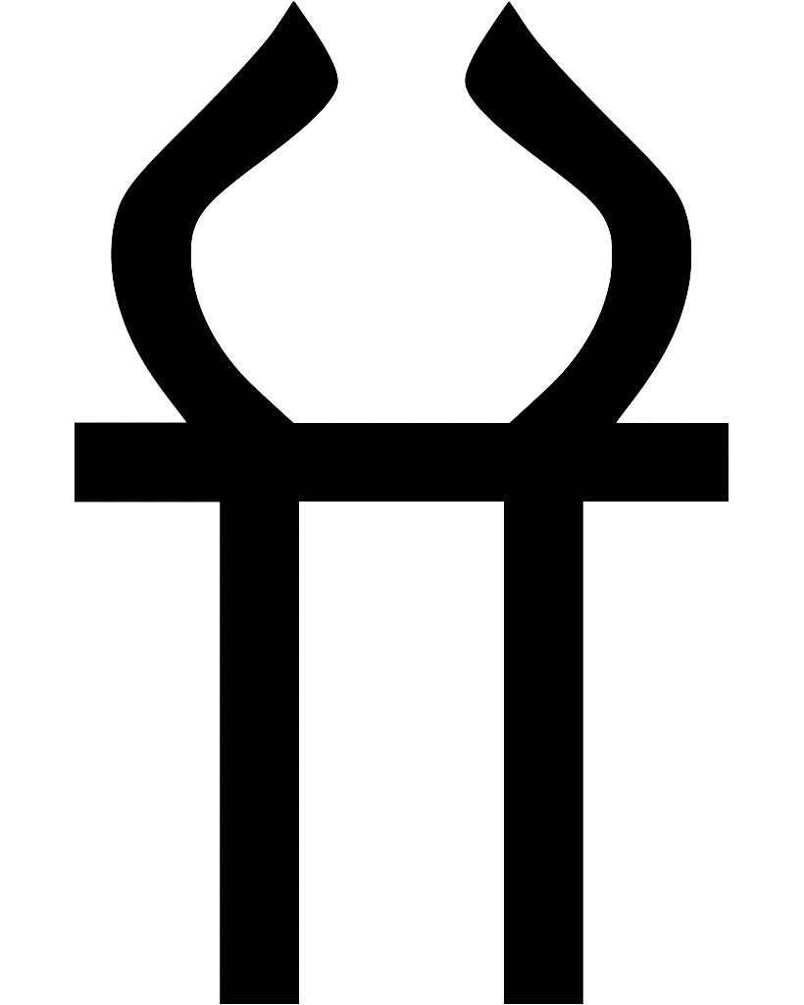
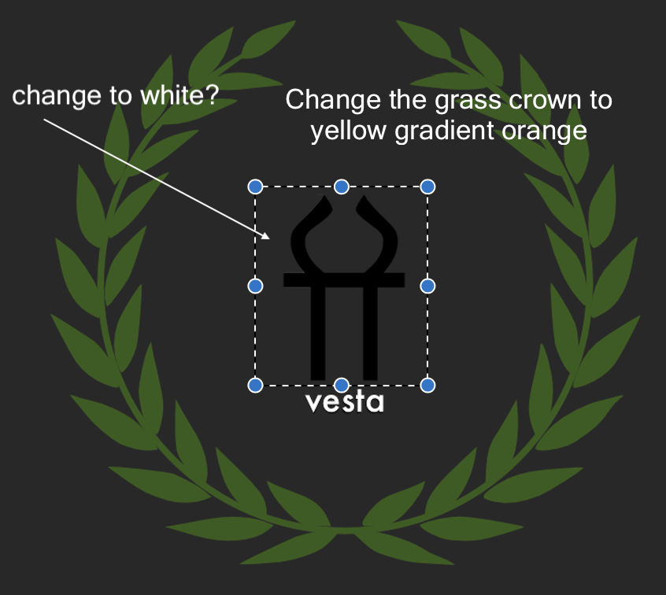
Vesta
This is is the symbol for Vesta (Roman Form) — also known as Hestia in Ancient Greek mythology. She is the goddess of the hearth and used to be one of the 13 Olympians
The grass crown is what every Greek, roman hero receives from quests or doing an extreme good deed for the nation.

Slide 2
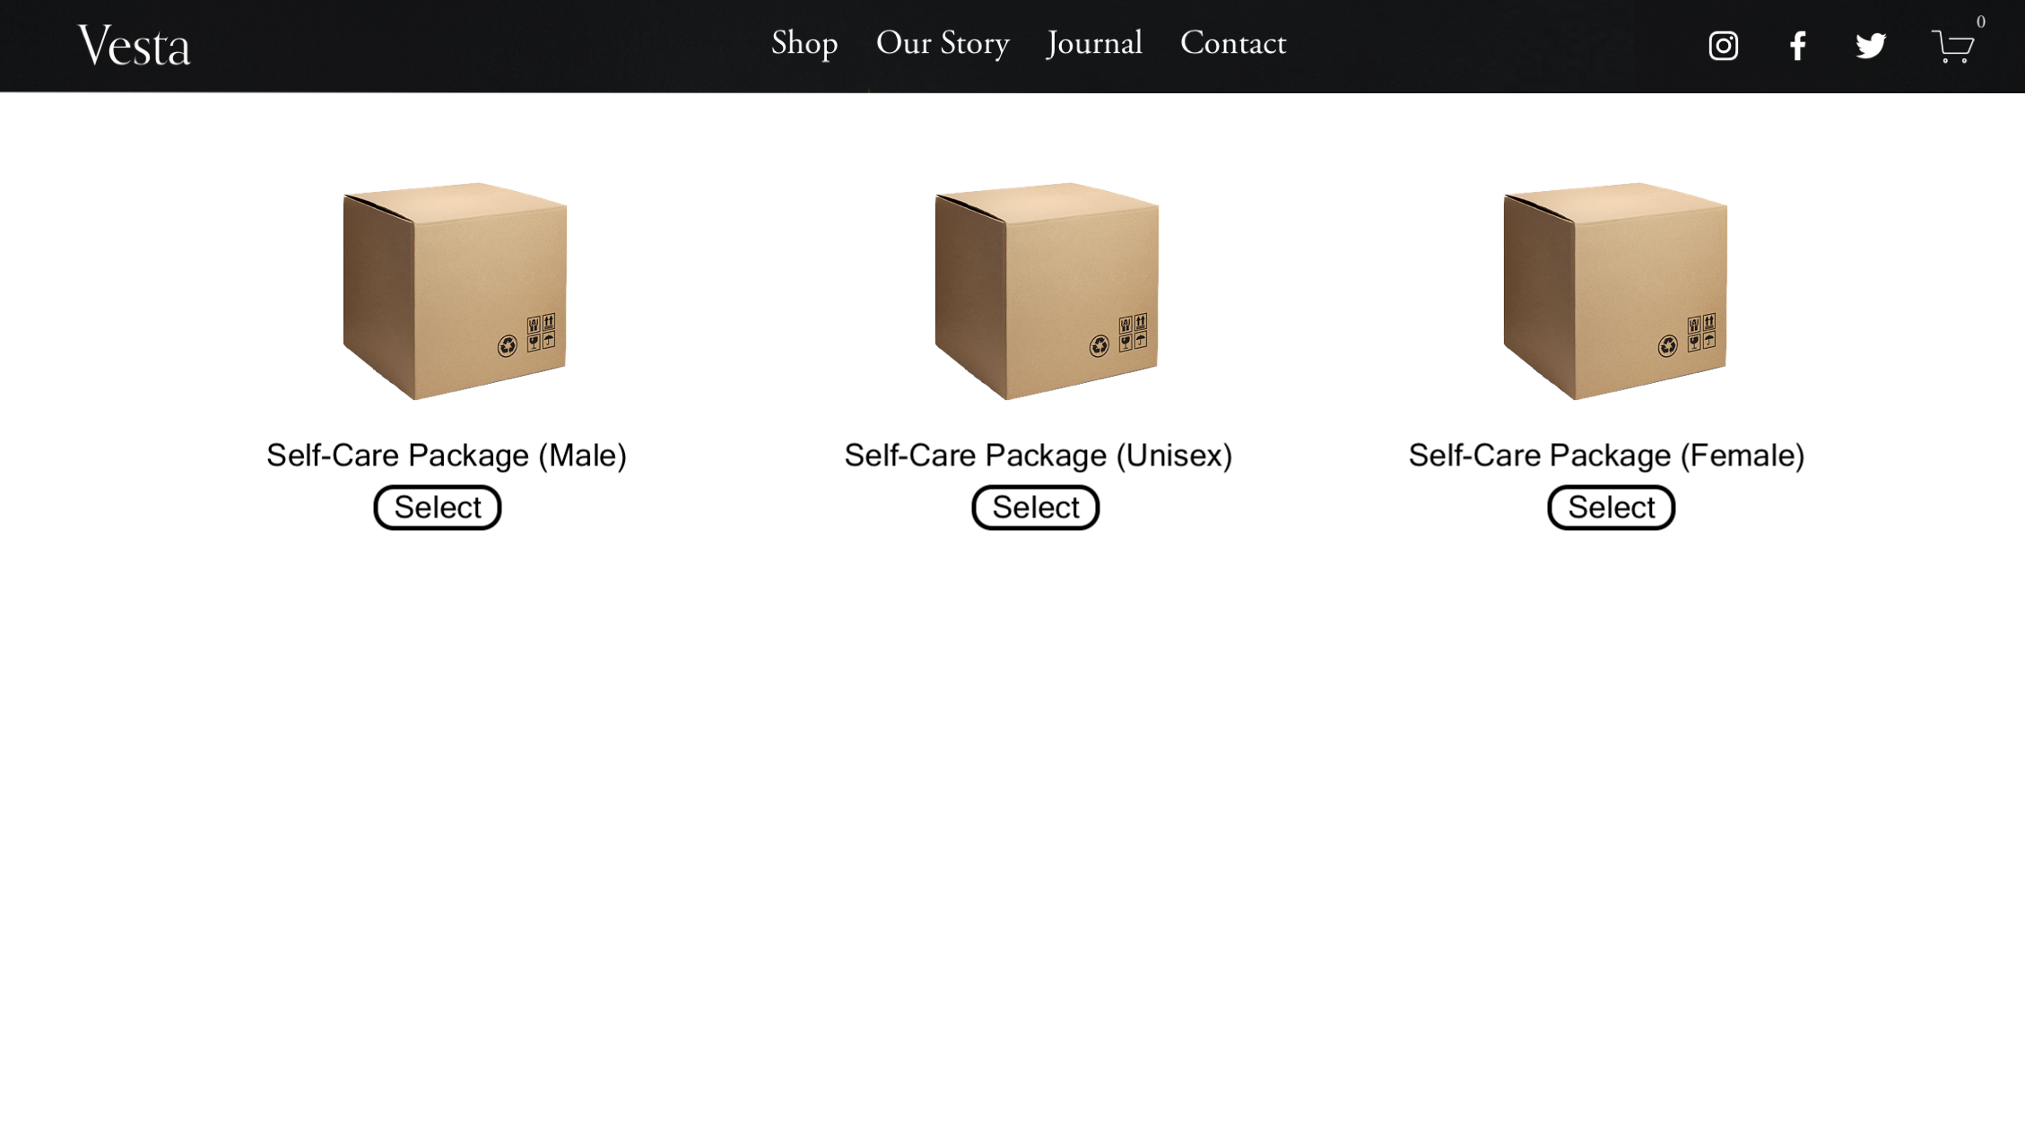

Slide 3
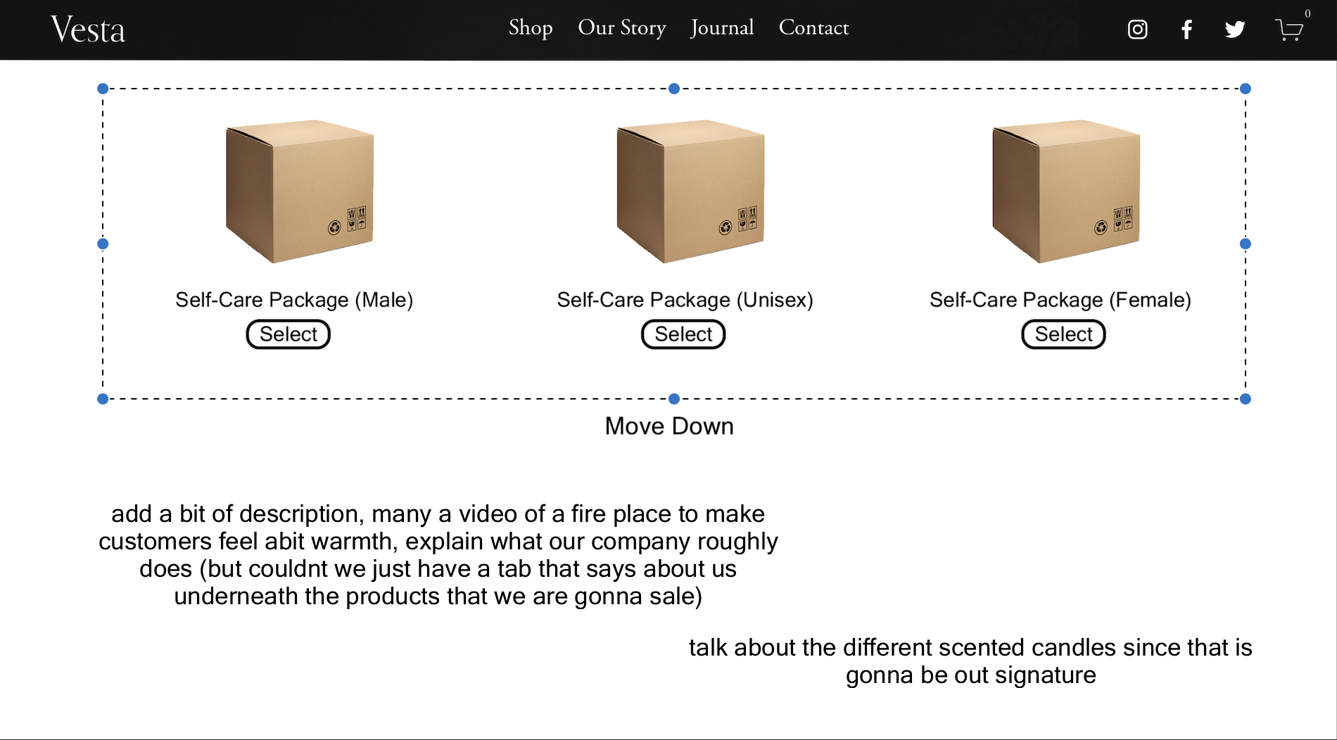

Slide 4
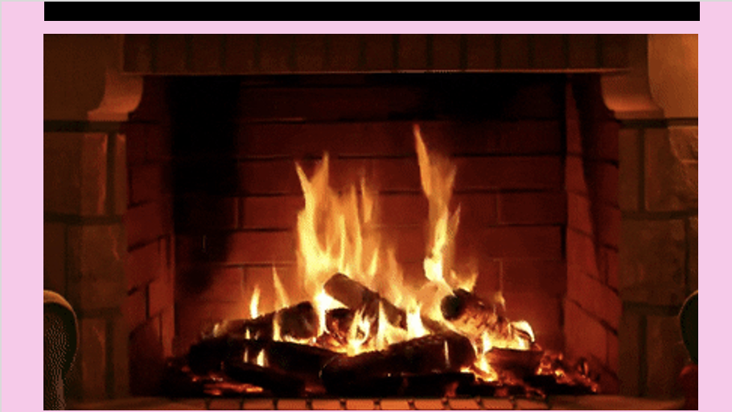
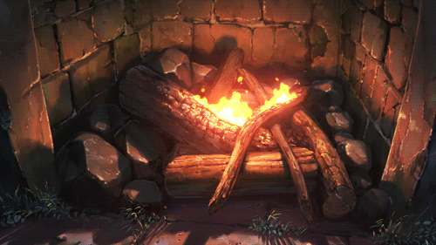
As Tia suggested, we should put a nice fire-place gif below the products to welcome and make customers feel warmer.
I think if we if add a background music to the website such as blues, jazz or a mixed playlist that when the customer is browsing through the different products, they would feel have a better impression and would be more likely to buy our product.
I think the second fireplace gif would be nicer since its more animated and it relates to many trends. I would say majority of people would watch anime and would also relate if something was related to their life while shopping.

Slide 5
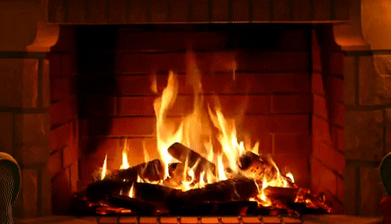
1.

Slide 6
2.

Slide 7
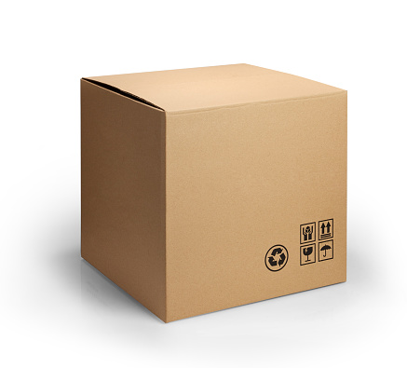
I think we should include Lexie’s idea or at least try to interpret it into the website. (so that we could at least have a chance in winning the best young enterprise website competition thing)
Another idea was Isy’s, which was based on aesthetic, I don’t see a major problem with this since a lot of people these days are into this.
Bath Bombs [_]
Baby Blue Base (Box)
Candle [_]
__________🔽
Face Masks [_]
Product [_]
Light Lilac Purple (Box)
Product [_]
__________🔽
Product [_]
Pick and Mix Idea
Navy Oceanic Blue(Box)
__________🔽

Slide 8
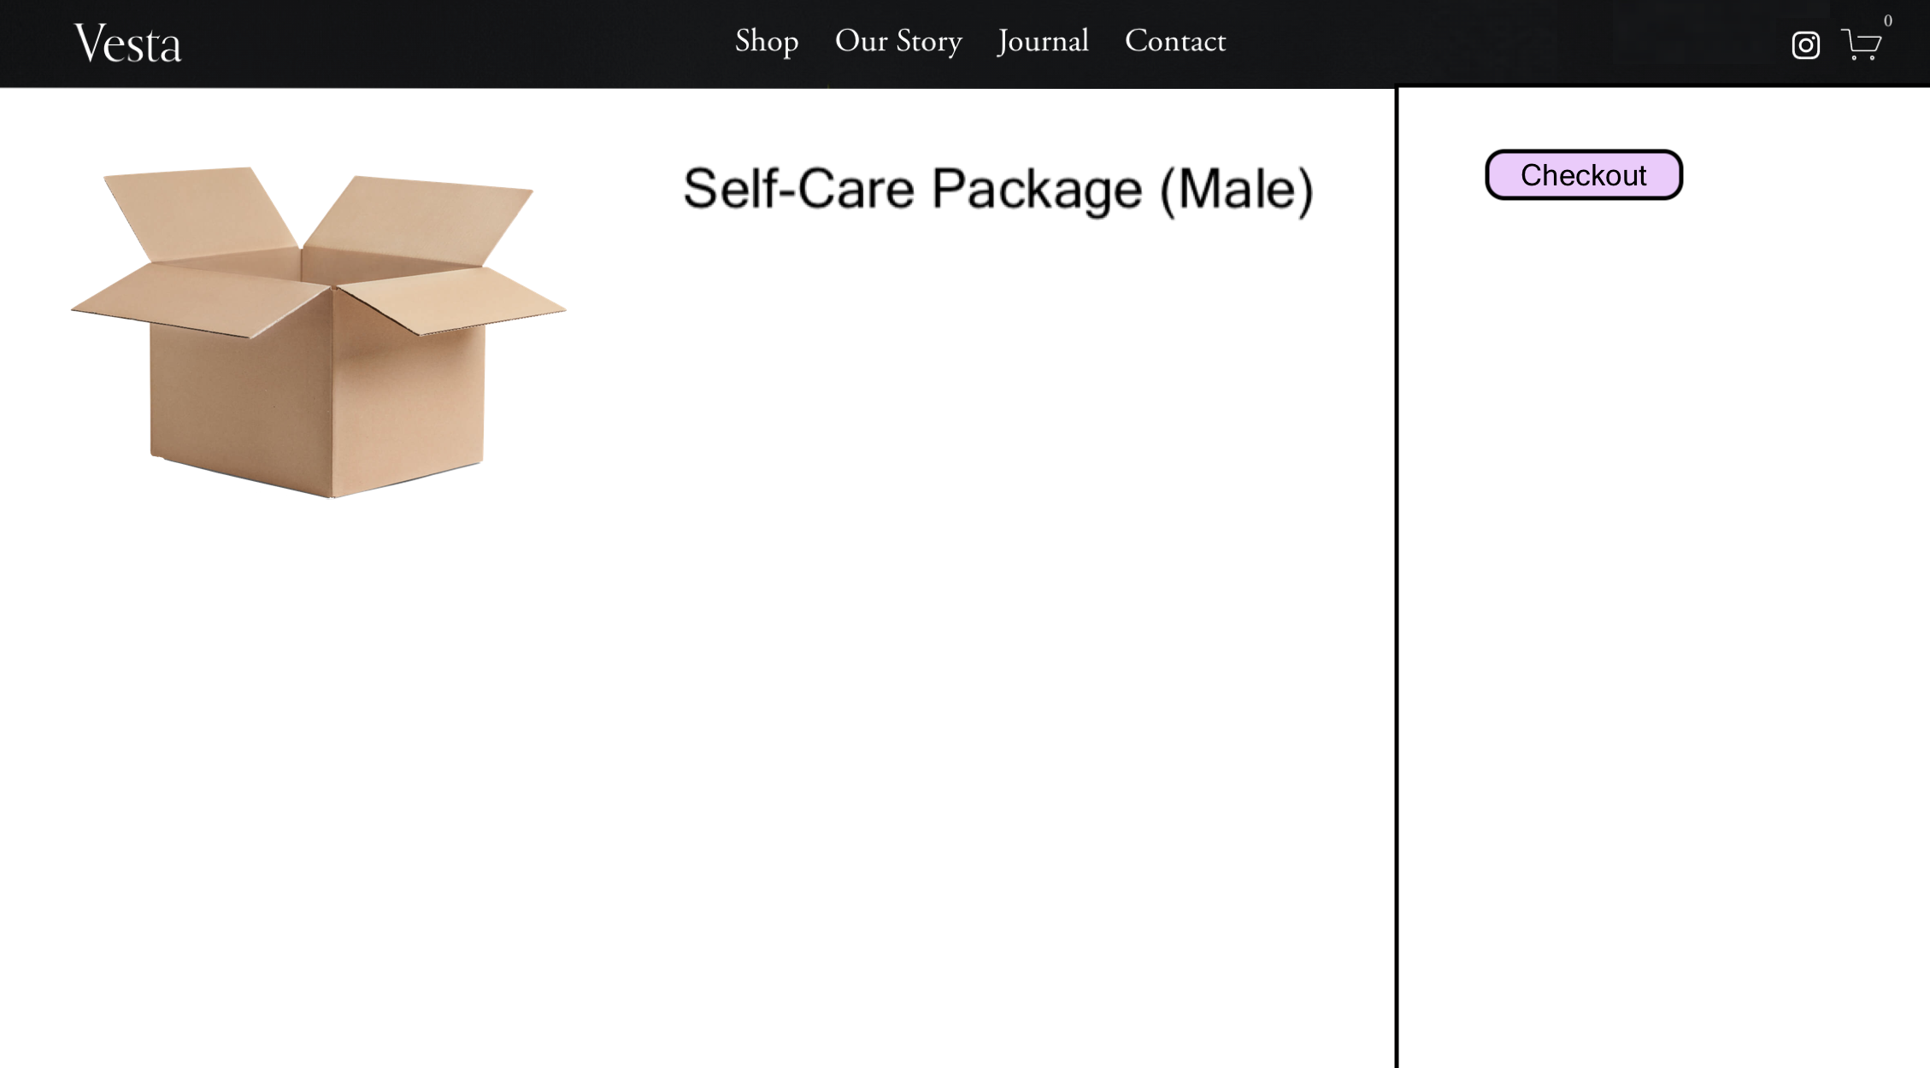

Slide 9

This product might contain allergens that might trigger the user.
— (state the allergens)
— (state what everything is made from)
— (state where the products are sourced from)
— (show that we care for the customers as our priority)
— (make everything simple and nice, don’t over complicate things)
—

